Slide 1
Chapter 9
DYNAMIC MODELING

Slide 2
Chapter Topics
Dynamic modeling and its relationship with behavioral and structural modeling.
How objects interact by exchanging of messages.
The role of parameters and return values in exchanging messages.
The significance of methods and their relationships with operations.
Events and their significance in dynamic modeling.
How to use sequence diagrams to create a chronological model of interaction among objects.
How collaboration diagrams represent the organization of objects that must cooperate to reach an objective.
Statechart diagram, the tool that models the changes of a single class of objects through their lifetime.
Revisit activity diagram and learn more about its capabilities.
9- <number>

Slide 3
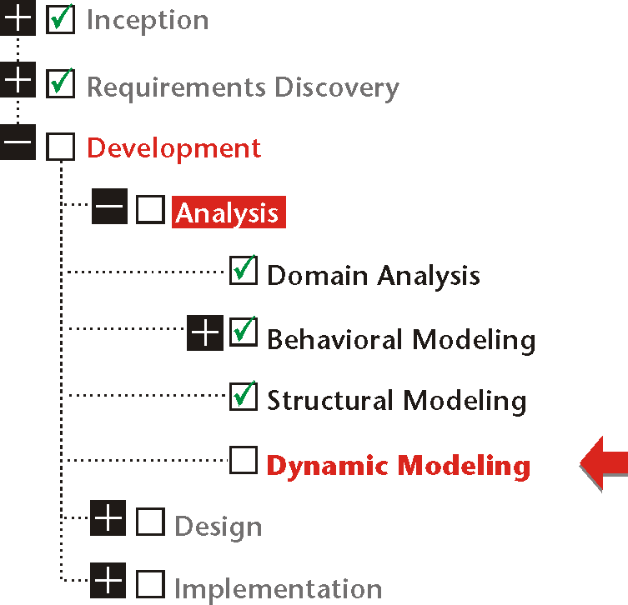
9- <number>

Slide 4
Dynamic Modeling
Dynamic modeling represents the interaction of the building blocks of the information system with each other and with the outside world to satisfy the behavioral requirements of the system.
9- <number>

Slide 5
Dynamic Modeling
Dynamic modeling is also interaction. Unlike the real world in which objects interact in many different ways, residents of a virtual world can only interact through messages.
Dynamic modeling features objects.
Interactions happen in time. Therefore, dynamic modeling must show not only
who interacts with whom and how, but in what order.
9- <number>

Slide 6
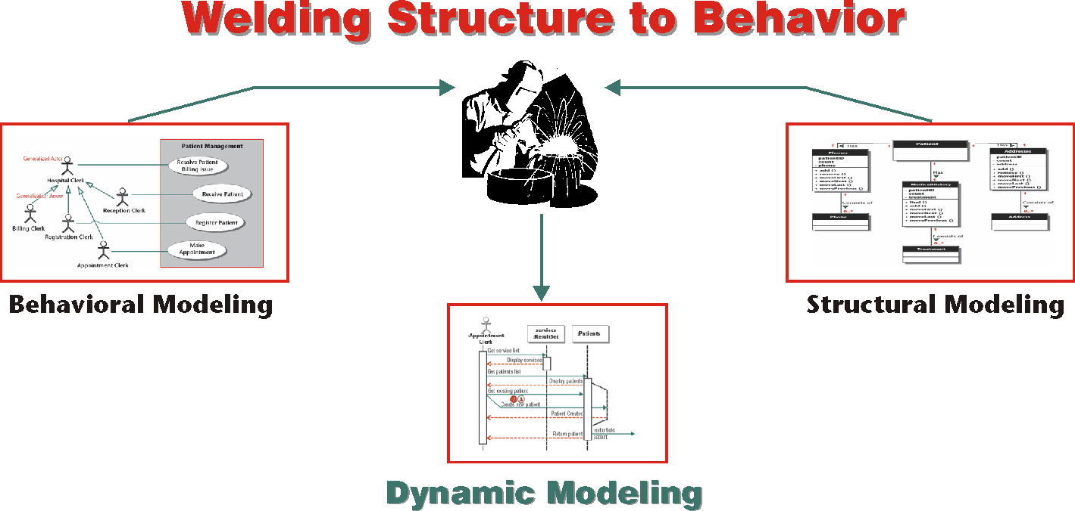
To arrive at a dynamic view of the system, we must place its structure within the context of its behavior.
9- <number>

Slide 7
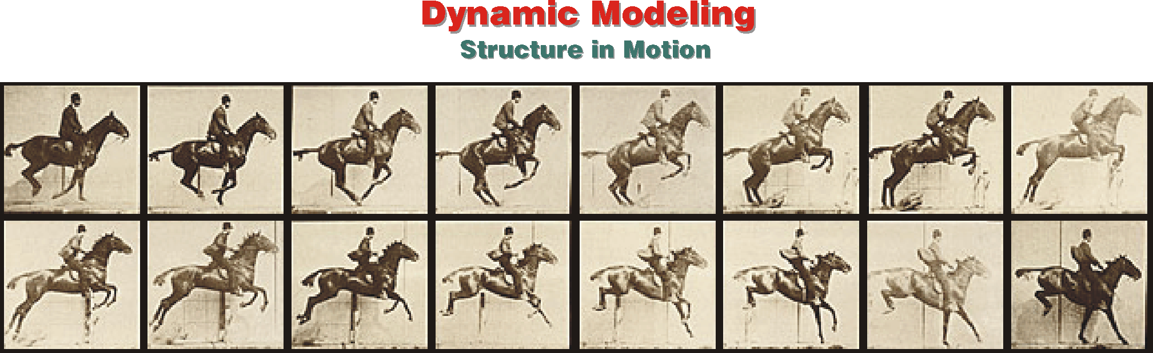
Dynamic modeling represents structure in motion.
9- <number>

Slide 8
Object Interaction
Dynamic modeling is about objects—their interactions and how the objects change through interaction.
In an object-oriented virtual system the only possible way of interaction is through sending and receiving messages.
9- <number>

Slide 9
Restaurant Example
Use Case: | Have Dinner
Scope: | Restaurant
Primary Actor: | Customer
Normal Flow: | 1. Customer is seated at a table 2. Customer asks the waiter for the menu. 3. Customer orders drink(s). 4. Customer orders appetizer(s). 5. Customer orders main course(s). 6. Customer orders dessert(s). 7. Customer asks for the bill. 8. Customer pays the bill and receives change (if any).
Alternate Flow / Exceptions: | 1.a Customer asks the waiter for his or her name.
9- <number>

Slide 10
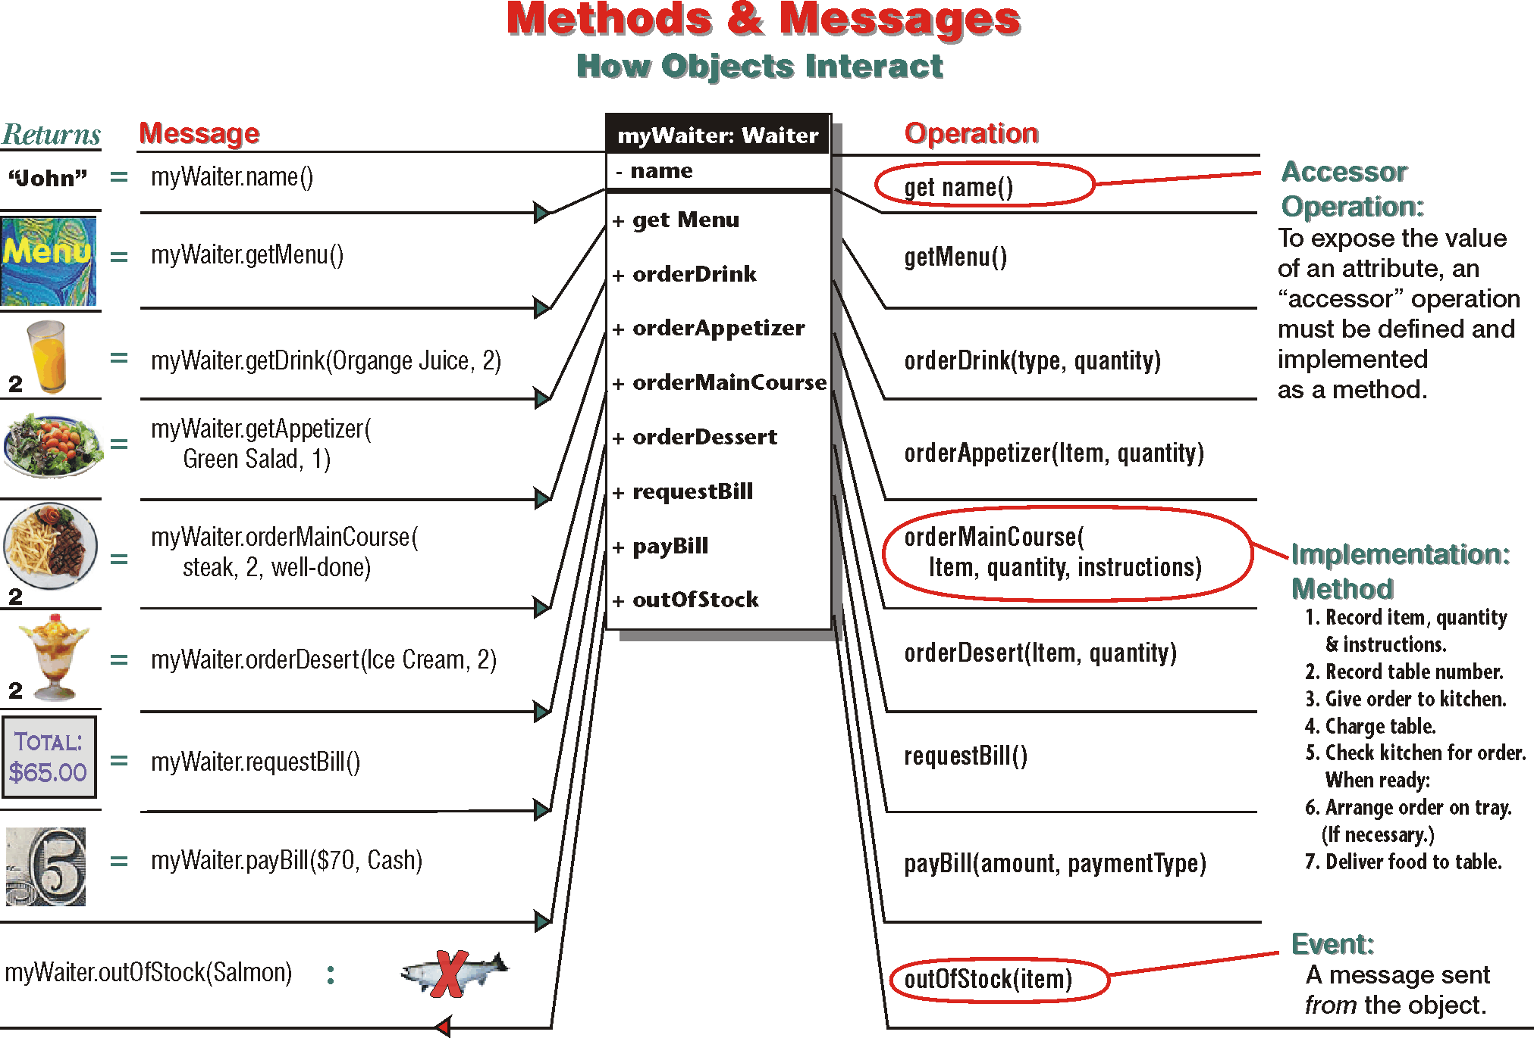
9- <number>

Slide 11
Accessor Objects
Accessor operations change or return the value of an attribute.
    The get operation returns the value of the attribute to the public.
    The set operation changes the value of the attribute.
  The syntax of an accessor operation is different from that of a normal operation.
    getName()
9- <number>

Slide 12
Parameters
Parameters, or arguments, specify the data that must be supplied to an object to carry out a specific operation:
Examples:
  orderDrink(drink, quantity)
  orderAppetizer(Appetizer)
  getMenu()
  orderMainCourse(whisky, on the rocks, many)
9- <number>

Slide 13
Messages and Operations
The syntax of a message matches the operation’s names and parameters, but a message and its corresponding operation are phrased differently.
  orderDrink(Drink,Quantity)
  orderDrink(Orange Juice, 2)
The option to ignore the argument applies only to the message, not to the operation.
  orderAppetizer(Green Salad)
  orderAppetizer(appetizer, quantity=1)
9- <number>

Slide 14
Return Value
Return value is the reply that a message may invoke from the receiving object after an operation is complete.
9- <number>

Slide 15
Syntax
The exact syntax for declaring operations and sending messages is language dependent.
  [Visibility] [Return Type] [Name](Param 1, . . . , Param n)
  Public Currency payBill(amount, paymentType)
9- <number>

Slide 16
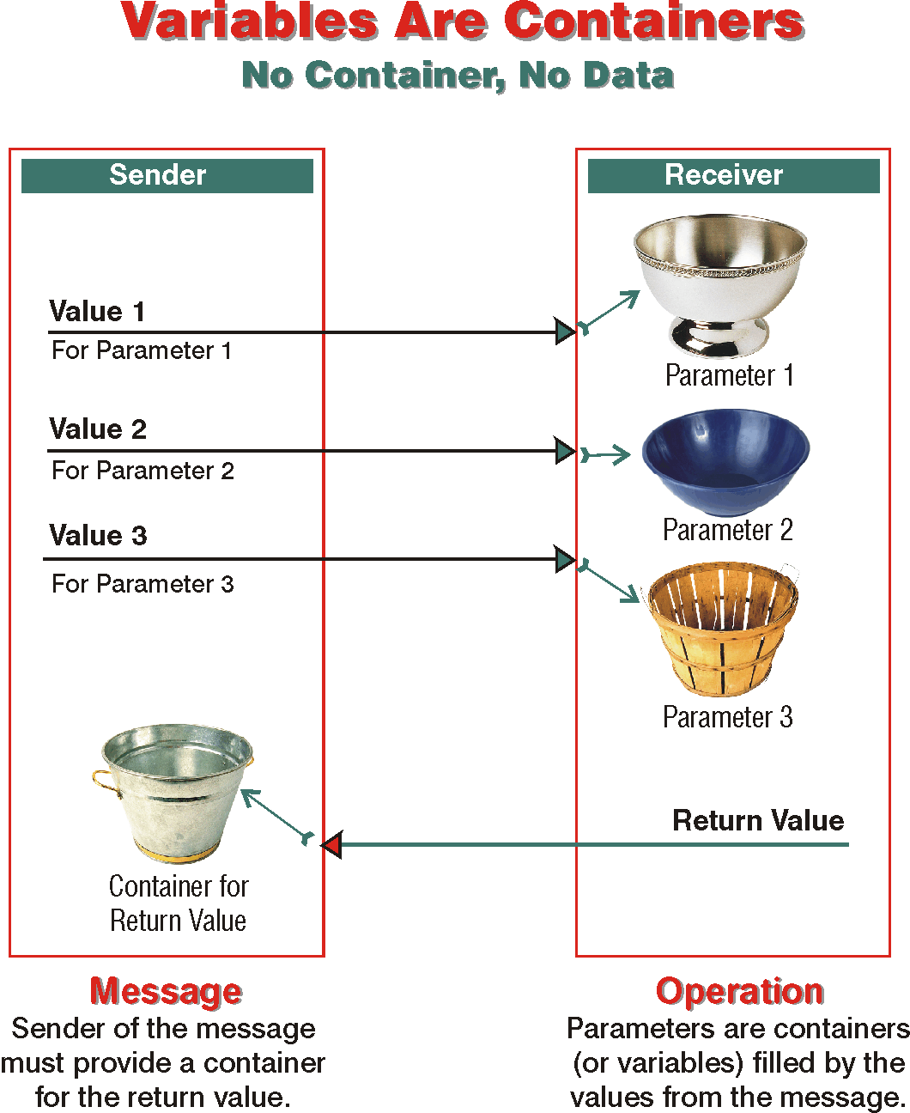
9- <number>

Slide 17
Methods
A method is how an operation is implemented or actually carried out by the object responsible for the operation.
  polymorphism; one operation => more than one method.
9- <number>

Slide 18
Events
Events are actions by one object that interrupt the existing condition of one or more other objects.
9- <number>

Slide 19
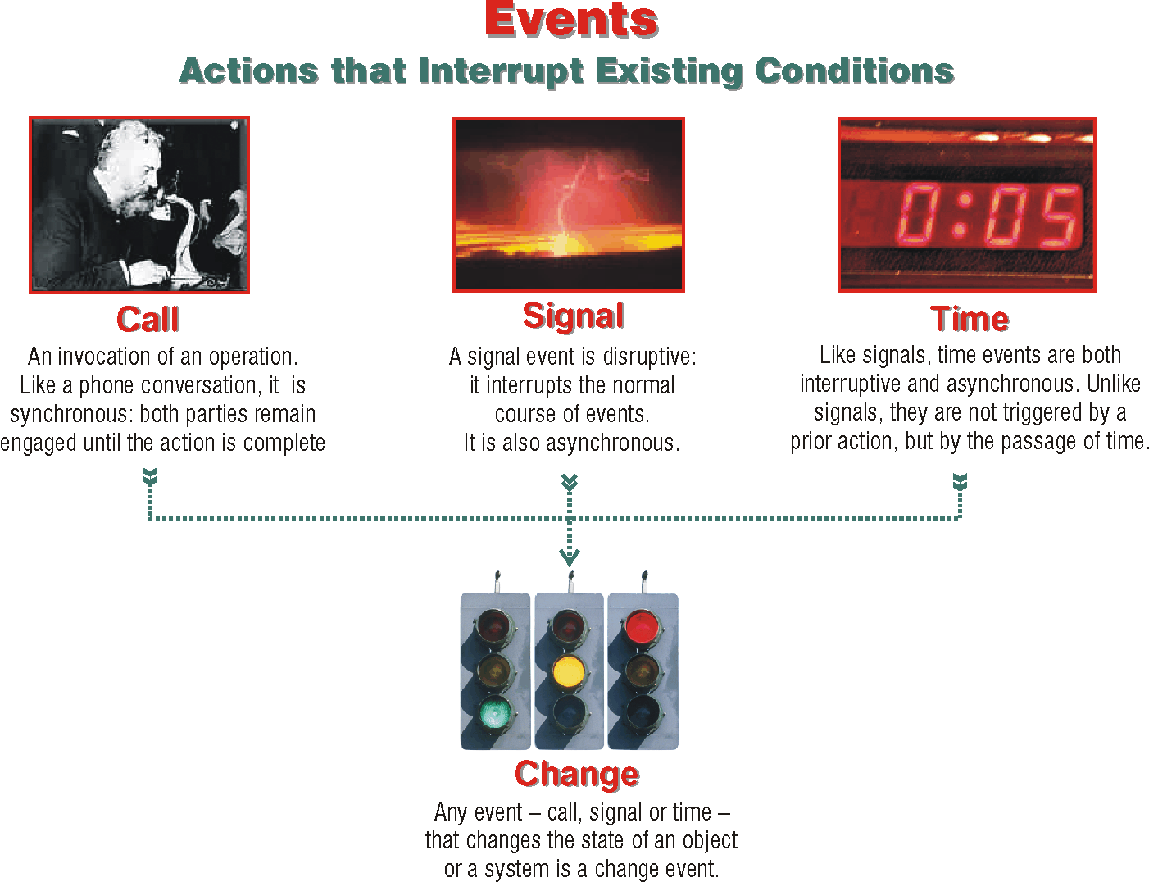
9- <number>

Slide 20
Dynamic Diagrams
Sequence diagram
      Emphasizes the order of interactions in time.
Collaboration diagram
    Focuses on how the object are organized and what set of messages they must exchange to satisfy a certain behavior.
State-chart diagram
    Traces the results of interactions on the state of objects belonging to a specific class.
Activity diagram
    Concentrates on the logical flow of activities.
9- <number>

Slide 21
Sequence Diagram
Sequence diagram represents the interaction between objects, or between actors and objects ordered in time.
A sequence diagram is composed of a timeline, objects that interact across this timeline, and the messages that they exchange.
9- <number>

Slide 22
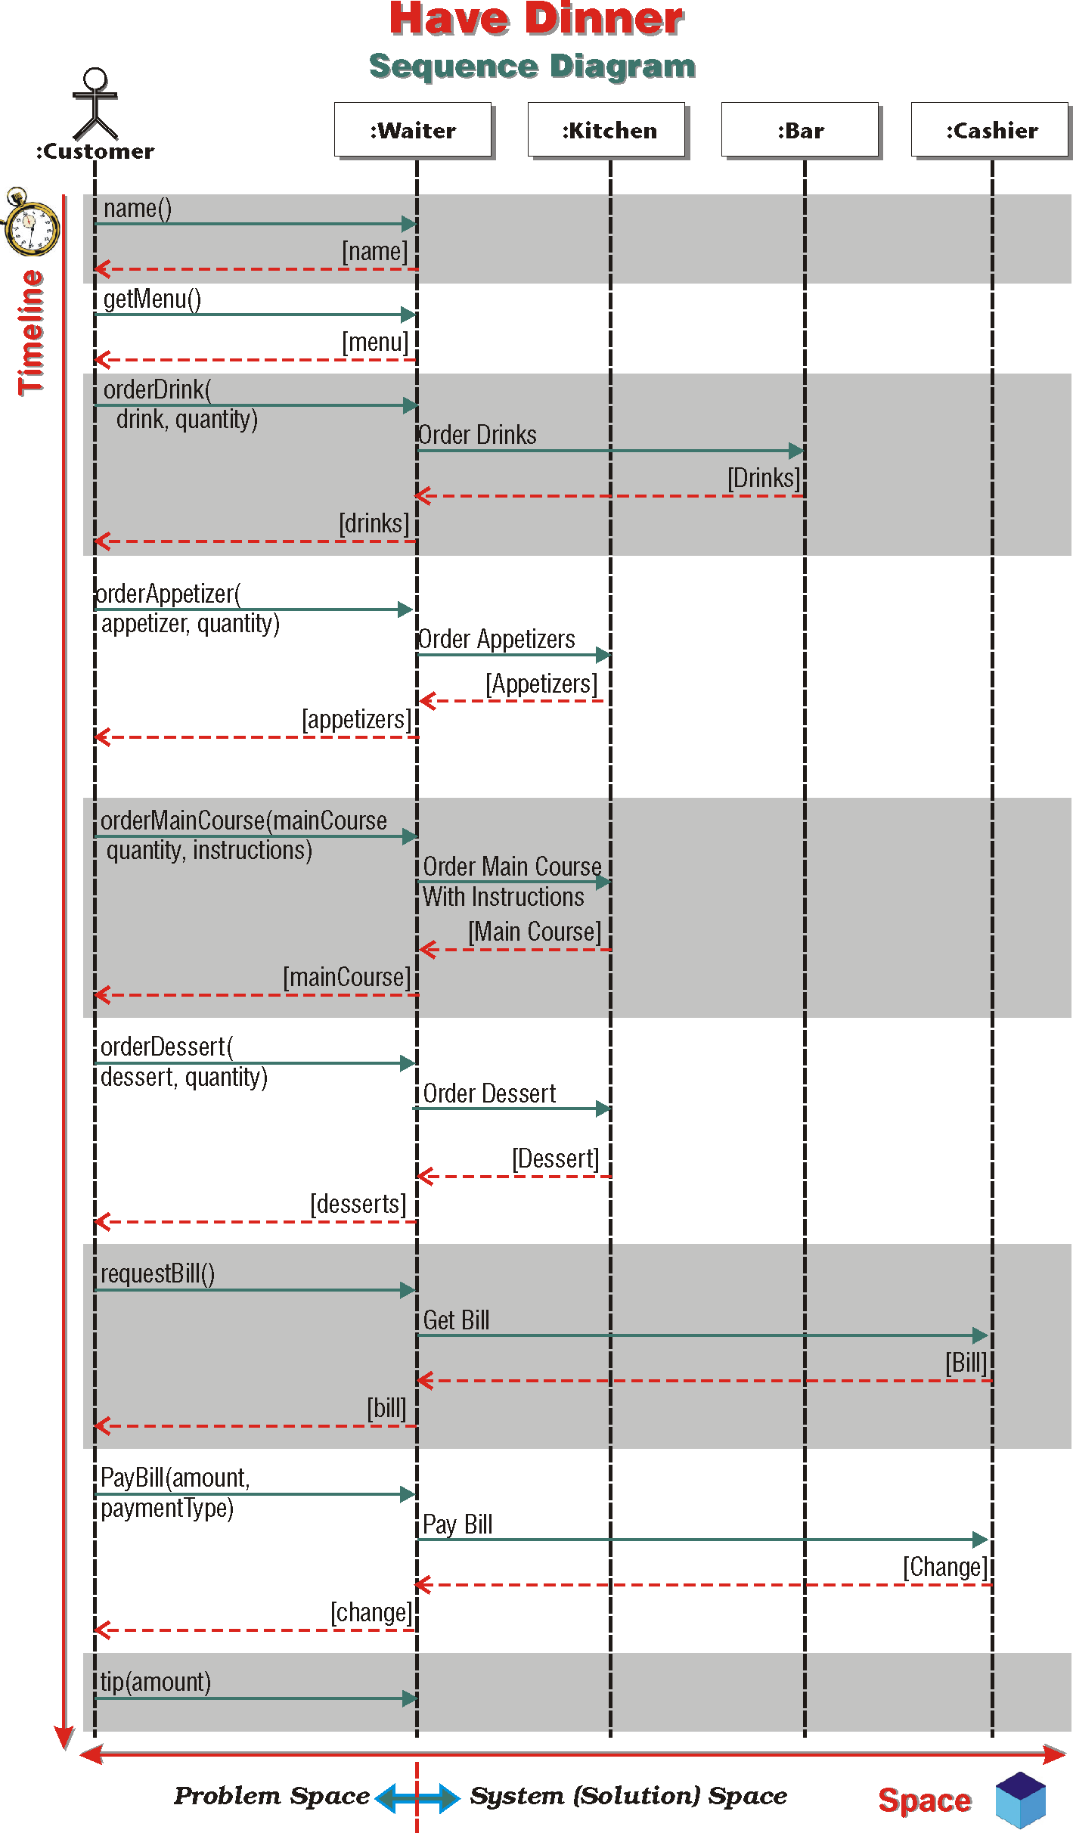
9- <number>

Slide 23
Sequence Diagram
The objects across the top of the diagram are interacting with each other by passing messages back and forth (horizontal).
An actor is the user whose interactions with the system are described in each of the use cases (horizontal).
The object lifetime represents time and starts with the top-most message (vertical).
9- <number>

Slide 24
Elements of Sequence Diagram
Actor Instance: outside the system.
        Instance Name:Actor Name
        aCustomer:Customer
Class Instance: inside the system
        Instance Name:Class Name
Timeline---dotted vertical line.
Object Lifetime: A hollow box on the timeline identifies the lifetime of an object.
Instantiation: specifies when the lifetime of the instance starts.
Destruction: specifies when the lifetime of the instance ends and the object is destroyed.
Message & Timeline Forking: Specifies alternates.
Message to Self & Looping: Specifies repeats.
9- <number>

Slide 25
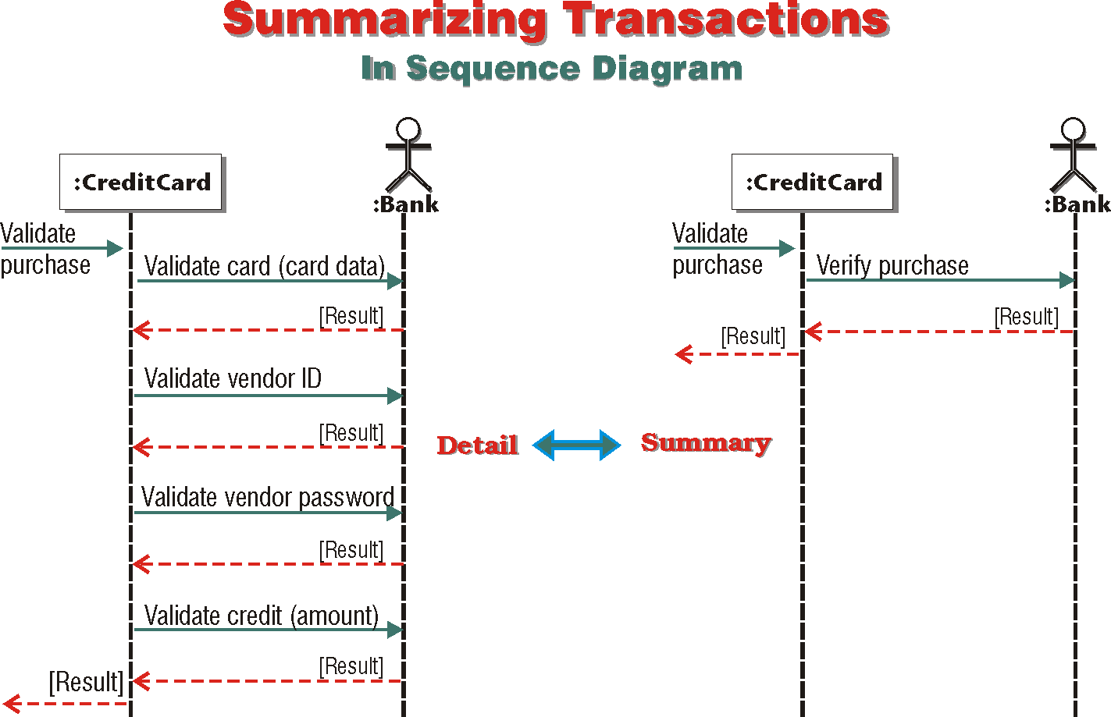
9- <number>

Slide 26
Object Lifetime
The lifetime of an object specifies when its instantiated, how long it exists and when it is destroyed.
9- <number>

Slide 27
Make Appointment - Use Case
Normal Flow: | 1. Appointment clerk verifies that the needed medical service is provided by the hospital. 2. Appointment clerk records patient’s personal and contact data. 3. Appointment clerk records information about the referral source. 4. Appointment clerk consults hospital’s schedule to find a free slot for the required medical service. 5. Appointment clerk verifies that the patient is available for the appointment. ➔ Loop 1: Repeat steps 4-5 until hospital’s schedule matches patient’s availability. 6. Appointment clerk makes the appointment. ➔ Loop 2: Repeat steps 4-6 for each appointment.
Alternate Flow/ Exceptions: | 2.a Patient is not on file. Create new patient. (Extend: 141 - Create Patient.)
9- <number>

Slide 28
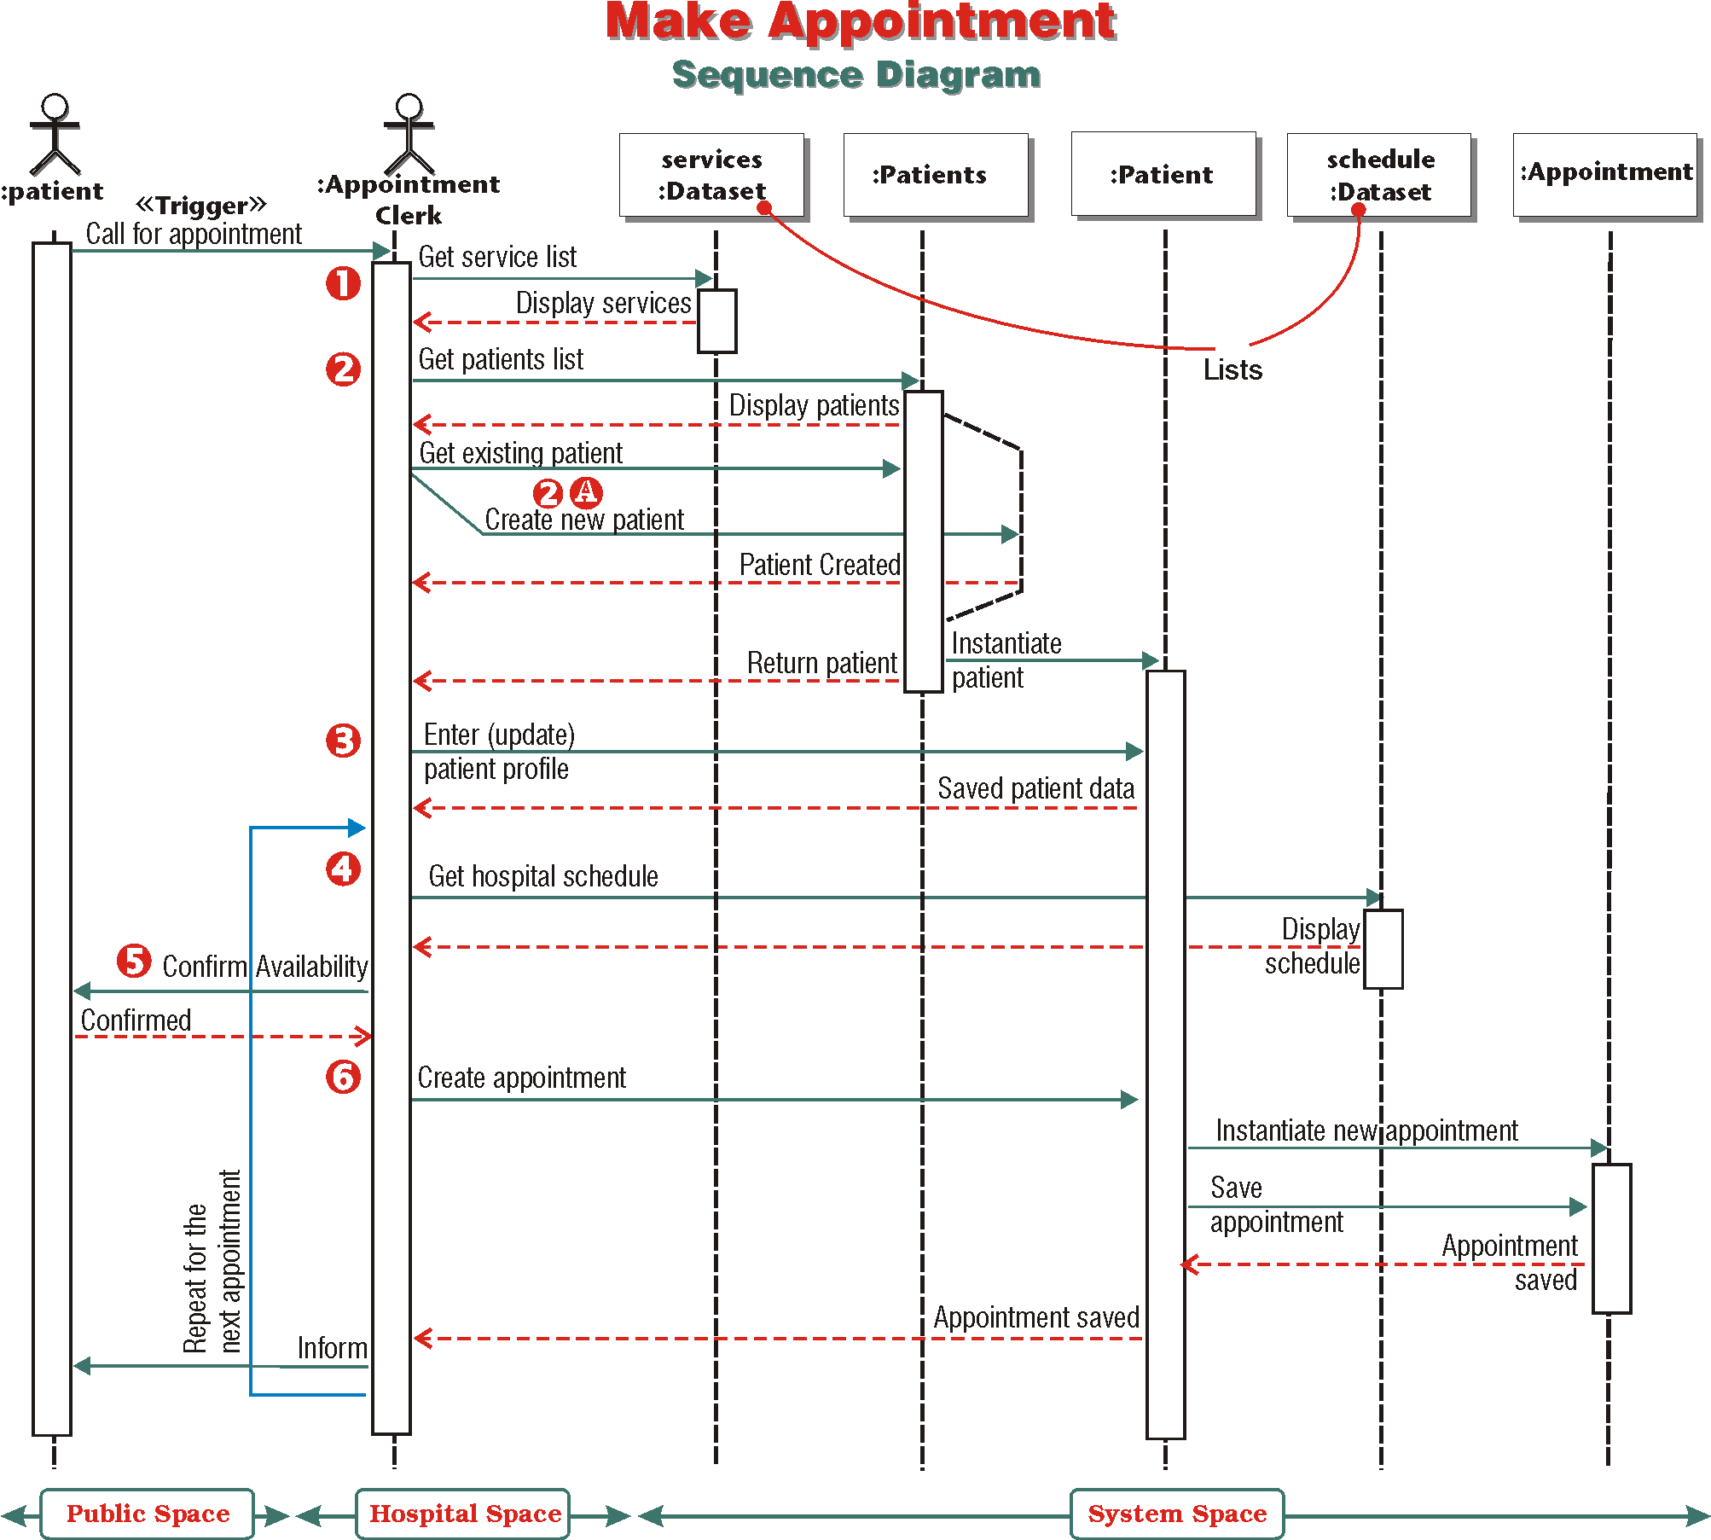
9- <number>

Slide 29
Tips for Drawing Sequence Diagram
Draw a sequence diagram for every use case.
Paste the text of the use case scenario into a note.
Map your use case text to the messages being passed on the sequence diagram.
Line up the text and message arrows.
Include alternates and loops.
Note: messages, methods, operations represent the behavior of a class.
(Refer to next presentation for more details of sequence diagrams)
9- <number>

Slide 30
Collaboration Diagram
Collaboration diagram is a dynamic diagram that focuses on the organization of objects that must cooperate, by exchanging messages, to satisfy a certain behavior.
Collaboration = Communication.
The best way to arrive at a collaboration diagram is to start from a sequence diagram.
9- <number>

Slide 31
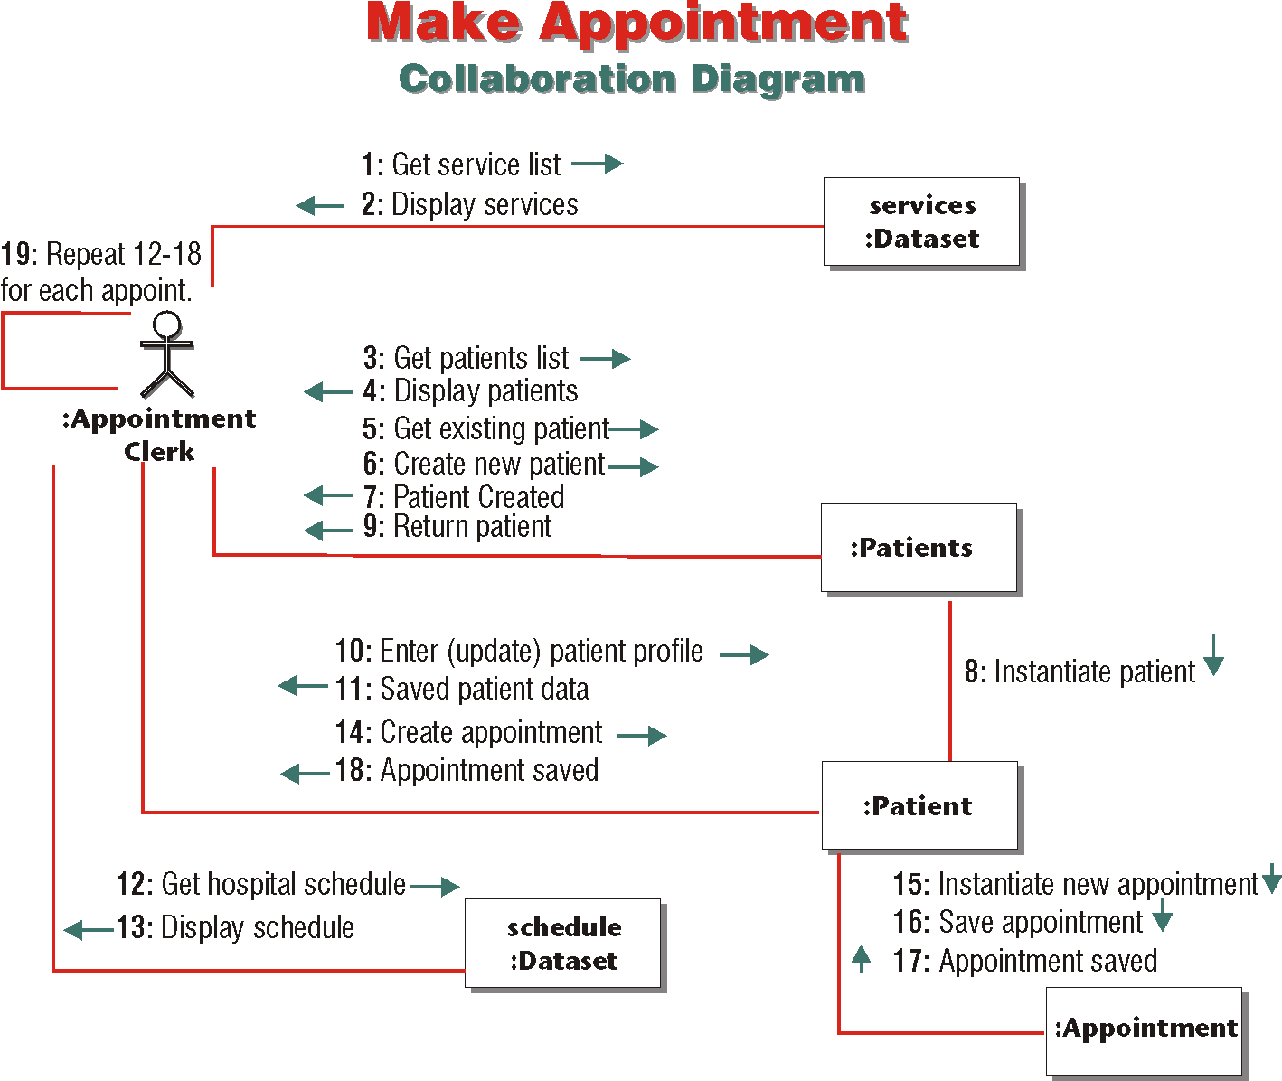
9- <number>

Slide 32
Statechart Diagram
Statechart diagram represents milestones in the lifetime of an object when its state changes.
A state is an object’s condition at a certain stage and from a certain viewpoint. It is a snapshot of the object in a usually important point in time.
Statechart diagram is composed of the states of an object and the flow of events that change its state.
9- <number>

Slide 33
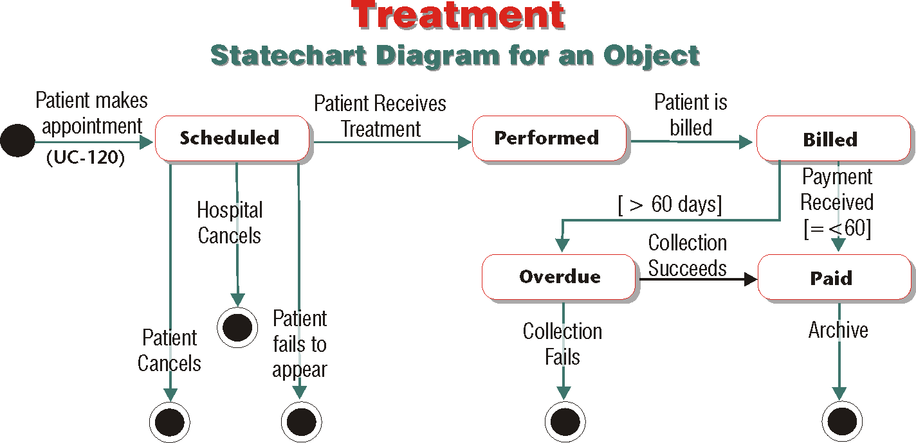
9- <number>

Slide 34
Elements of Statechart Diagram
Initial State (Starting Point)
State
Transition & Event
Final State (Termination Point)
9- <number>

Slide 35
The Value of Statechart Diagram
Statechart diagram is the only dynamic model that can illustrate the milestones in the lifetime of one class of objects in its entirety.
9- <number>

Slide 36
Activity Diagram
Activity diagram provides the most lucid tool for modeling the logical flow of activities that takes place between the system and the outside world or within the system among its components.
Activity diagram is concerned with the logical flow of activities in an almost pure form.
9- <number>

Slide 37
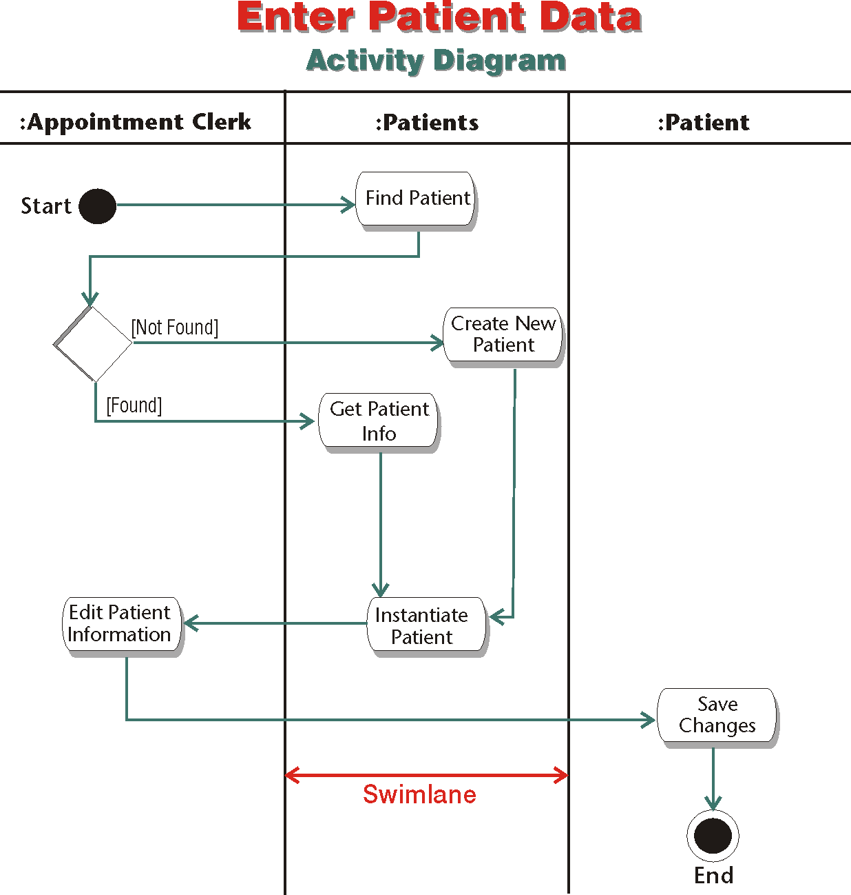
9- <number>

Slide 38
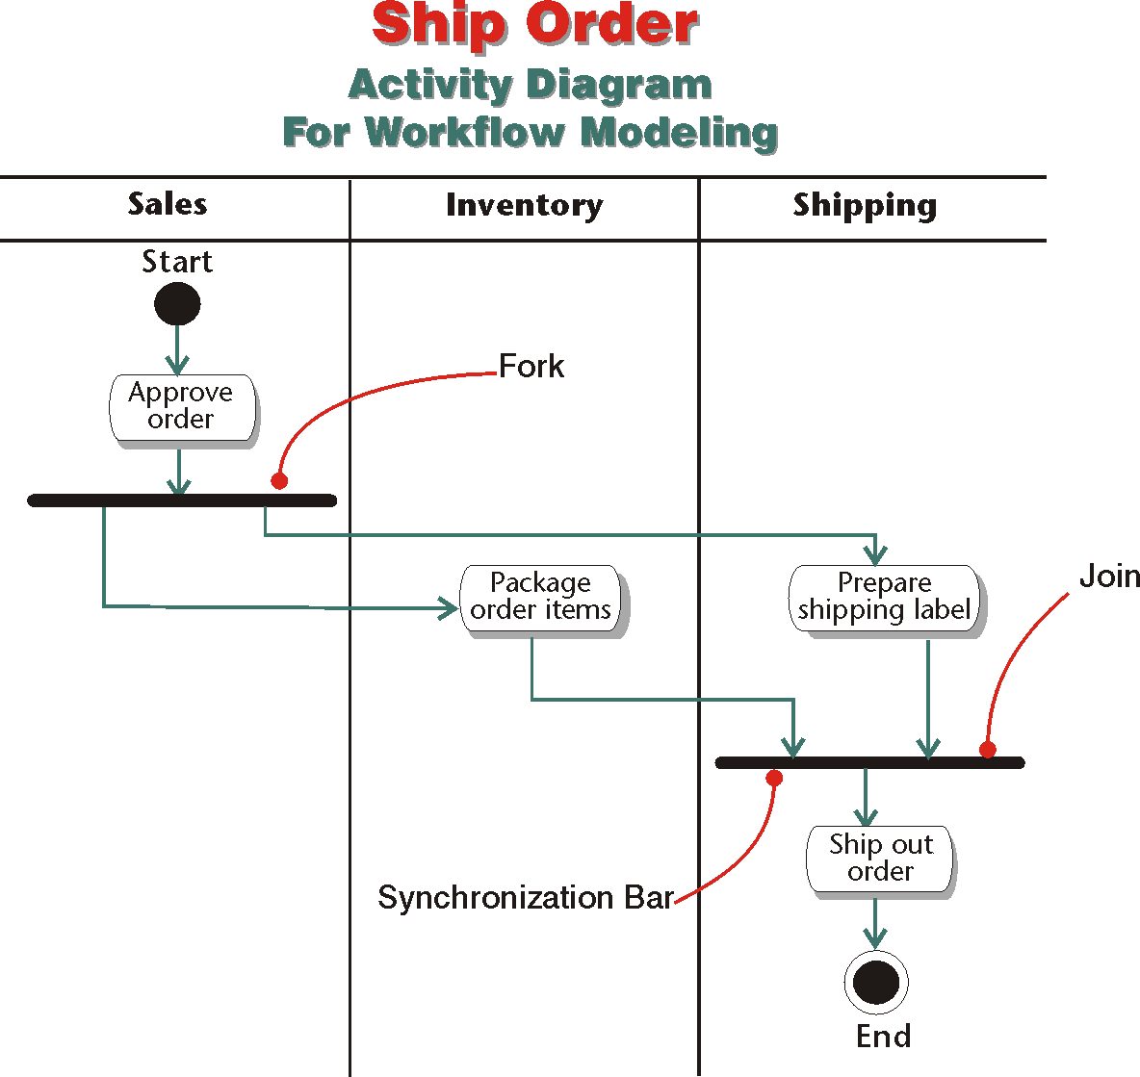
9- <number>

